Slide 1
Wifi Locations – Goals and objectives
To investigate the feasibility of using "wifi fingerprinting" to determine a person's location in indoor spaces.
Large database of wifi fingerprints for a multi-building industrial campus with a location (building, floor, and location id) associated with each fingerprint has been provided with approximately 20k observation and 529 variables.
We used r studio for this analysis with new variable called ‘id’ by joining floor ,building, spaceid and relative position .
All other variables outside of above and wifi location have been removed due to the irrelevance of this analysis
Near zero variance function has been used to remove variables with zero or minimal variance within the dataset. Building zero has been used by using filter function to train the dataset to shorten the process time which reduced overall observation to 5249 in companion to 20K .
The analysis used Random forest, KNN and SVM model for training the dataset.
The data was split %75 for training and %25 for testing

Slide 2
Random forest Model
Training Observation:3996
Testing Observation:1253
Accuracy: 83%
Kappa:82%
P_Value: 2.2e-16

Slide 3
Support – vector machines
Training Observation:3996
Testing Observation:1253
Accuracy: 72%
Kappa:72%
P_Value: 2.2e-16

Slide 4
K – Nearest neighbor
Training Observation:3996
Testing Observation:1253
Accuracy: 70%
Kappa:70%
P_Value: 2.2e-16

Slide 5
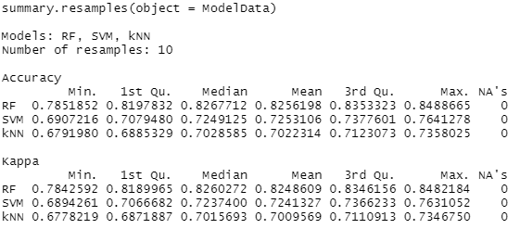
Model comparisons
We recommend to use random forest classification due to higher accuracy and Kappa along with resealable process time. kNN had the shortest process time

Slide 6
Recommendation
Narrow down the amount of variables, information such as PHONEID, USERID…etc, are only going to increase the process time.
Ensue that all the WAPS are working property, we reduced the number WAPS by over 300 due to mostly the lack of signals.
exploring other models (non –caret) might give a better results

